Slide 1
Techgig Video Analytics Hackathon Phase 2 - Prototype Development
Team name : INFOTECHIES
Team leader: GANESH KUMAR.K
Team members : RAMYA.A
RIZWANA.S
YASIKHASRI.G

Slide 2
Description of what the team has tried to build
The video feeds being captured by the dome cameras should be instantly uploaded to the cloud because we are using Microsoft Azure. The artificial intelligence created utilising the aforementioned Azure tools and services is then fed these captured films. The footage will subsequently be analysed by artificial intelligence, which will also provide video analytics. These analytics will be able to identify consumer sentiments, count the number of persons in the film, and determine how long an activity took place on the bank's premises. We need graphs for all the analytics, along with summaries that will make it easier to comprehend them. Since we intend to use Microsoft Azure, the scalability is determined by the quantity of virtual machines that are active at any given time. Scalability is predicated on Azure's capacity for growth.

Slide 3
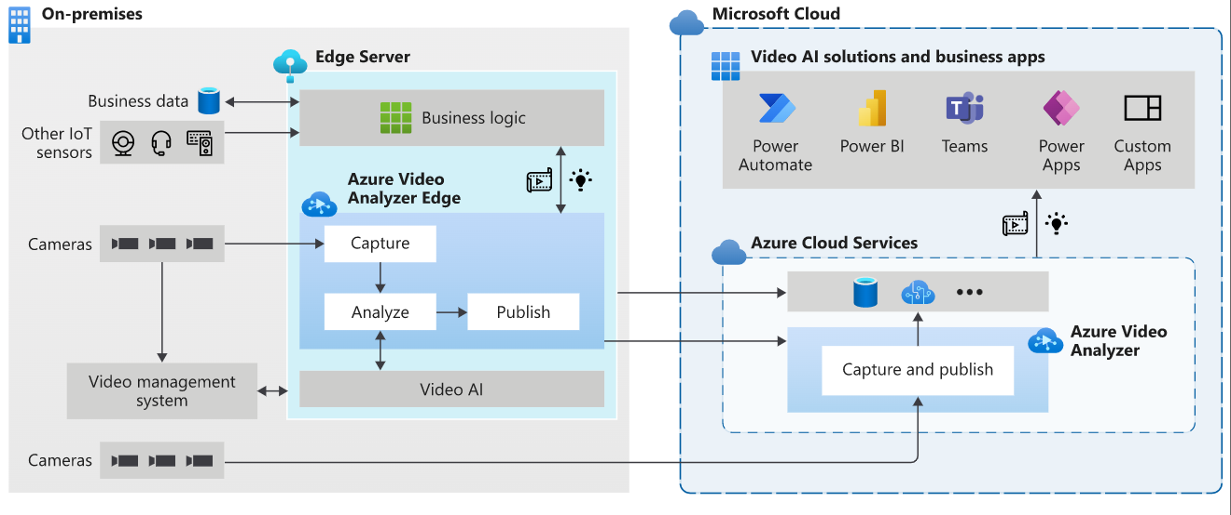
High-level implementation/solution diagram

Slide 4
Tools,Technology Stack(including the APIs consumed),and framework details
Azure Video Indexer
Azure Video Analyzer (Depracated)
Sequential AI composition

Slide 5
the algorithm/machine learning models that have been used in the hackathon prototype
Backpropagation algorithm
Face alignment algorithm
Deep Learning Algorithms with Applications to Video Analytics Paper, by Li Wang. IEEE and Dennis Sng

Slide 6
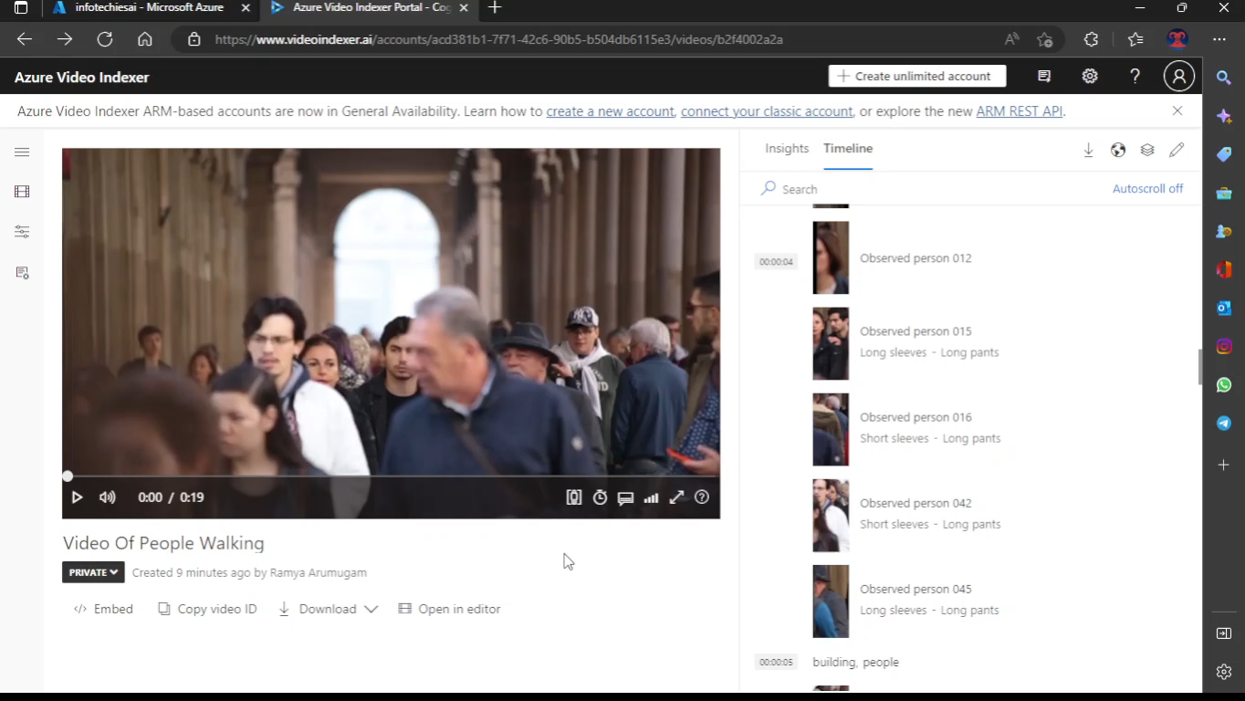
A demo video showing the functionalities of the application

Slide 7
A write-up on why your application/solution should be considered
From both the stream side and the cloud side, our solution is entirely automatic. After development, our steps will make it simple to implement the solution for the bank. As part of our approach, we will first gather recording from the bank, utilise those to train the artificial intelligence we will develop using machine learning, and then optimise the artificial intelligence to deliver better video analytics.

Slide 8
Ability to scale-up in enterprise grade environment
Since we are using Microsoft Azure AI services as the main technology for this prototype, the scaling to an enterprise grade environment is directly proportional to the scaling ability of the Azure AI services provided by Microsoft.
About the scaling possibilities from the application part. This prototype is not immediately scalable to the required scale. But it can be modified and developed further to accommodate the expected scale.

